Slide 1
Module 3: From Continental to World Power
Talk | Title | Time Period | Date of Talk
16 | Competing destinies | 1848-1854 | March 4th
17 | The Union falls apart | 1854-1861 | March 18th
18 | Civil War | 1861-1865 | Wednesday April 3rd
19 | Reconstruction & the New South | 1863-1900 | April 15th
20 | Conquest of the West | 1865-1900 | April 29th
18 | Civil War (Repeated) | 1861-1865 | Wednesday May 8th
21 | The growth of the North & triumph of capital | 1865-1900 | May 20th
22 | A world power emerges | 1890-1904 | June 3rd

Slide 2
The plan….to end of Module 3
1861-1865
1865-1900
1890-1900
Reconstruction &
New South
Civil
War
A World
Power Emerges
Conquest of the
West
The growth of the North & Triumph of
capital

Slide 3
American History
1
Talk 19: Reconstruction & the New South 1863-1900

Slide 4
Overview
Lincoln assassination and its aftermath
Reconstruction 1865-1868
Radical Republican Reconstruction 1868-1877
The New South 1877-1900
History of history

Slide 5
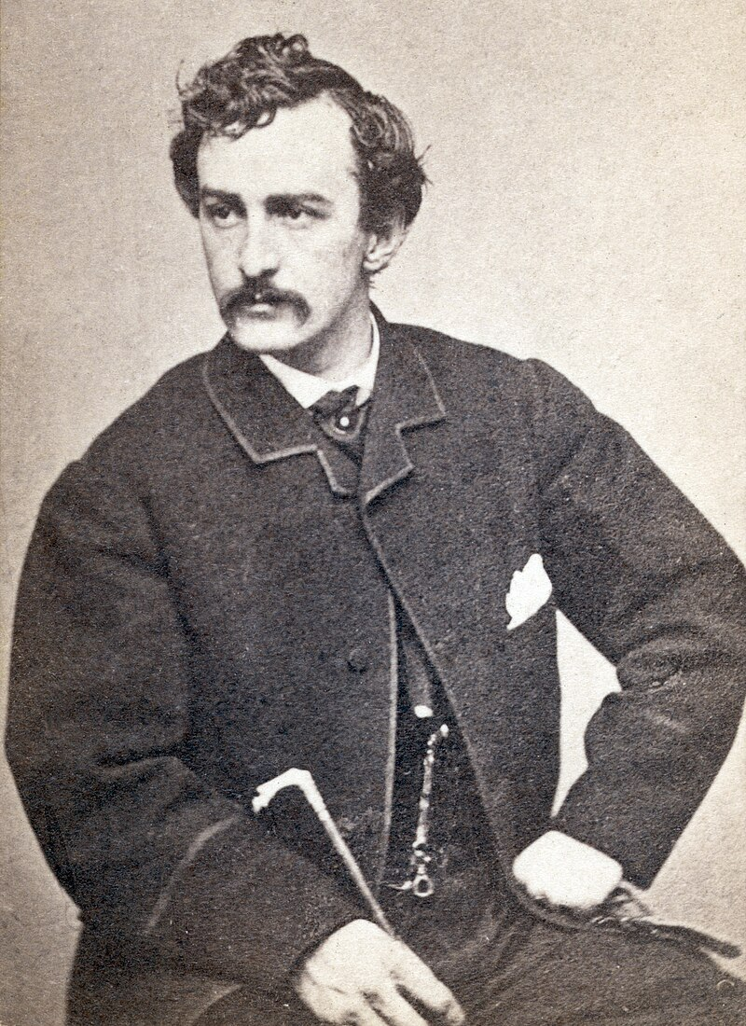
The Conspiracy
John Wilkes Booth
Family of successful actors. Edwin Booth brother more well known…John jealous of his success
Stays at boarding house in Washington
The proprietor Mary Serrat …all lodgers Couriers
Passing messages to/ from Confederate Army
Booth and others plan to kidnap Lincoln during war.. to exchange for prisoners. Idea falls apart
Lee surrenders…cause lost
Lincoln gives speech proposing giving “very intelligent
Blacks” plus those with military experience vote
……Booth “Something great must be done”
Group of 4 meet at Serrat’s boarding house in
Washington…decide to kill Lincoln, VP Johnson, and
Secretary of War at 10 pm night of April 14th

Slide 6
Lincoln’s dream
As reported to an aide two nights before “I kept on until I arrived at the East Room, which I entered. There I met with a sickening surprise. Before me was a catafalque, on which rested a corpse wrapped in funeral vestments. Around it were stationed soldiers who were acting as guards; and there was a throng of people, gazing mournfully upon the corpse, whose face was covered, others weeping pitifully. "Who is dead in the White House?" I demanded of one of the soldiers, "The President," was his answer; "he was killed by an assassin."^{[21]d}
Lincoln at theatre next to wife, General Grant, other members of cabinet & wives…box seat
…Booth enters theatre recognised and well known at theatre and no one suspicious
…approaches door to theatre box….guard has gone next door for a drink
…enters rear of theatre box

Slide 7
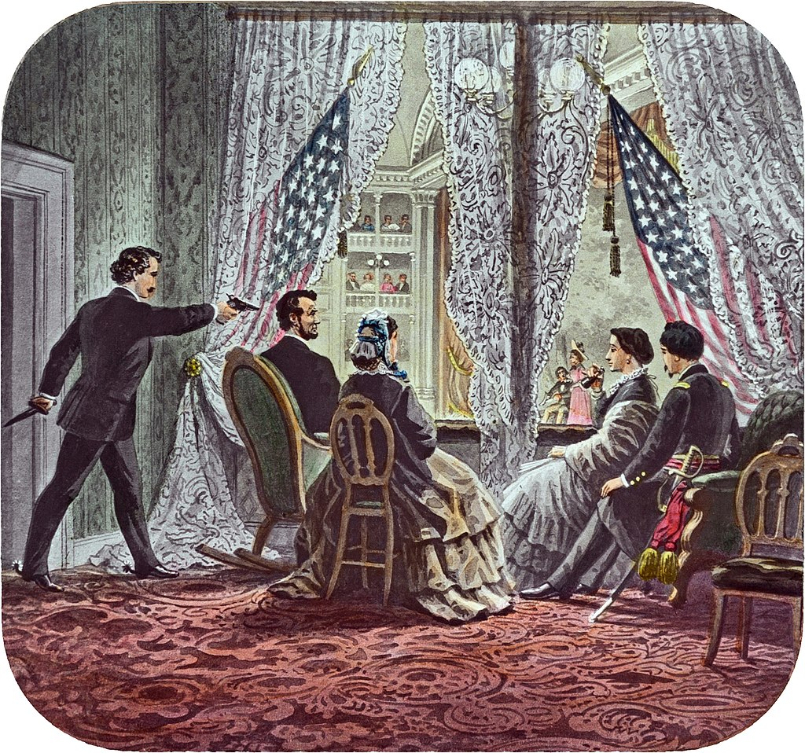
Lincoln’s assassination April 14, 1865 (4 days after Lee’s surrender)
Booth shoots Lincoln at point blank
Range. Leaps onto stage shouting
“Freedom” and escapes
Lincoln does not regain consciousness
Dies early morning
Assassination of Secretary of War fails
…..Stanton, in bed recovering from fall from stage
Coach
… Lewis Paine…gun misfires
….knife fight, Stanton Wounded…
….Paine flees scene
Attempt to kill Vice President fails
….would be assassin gets drunk
….abandons attempt
…flees to boarding house

Slide 8
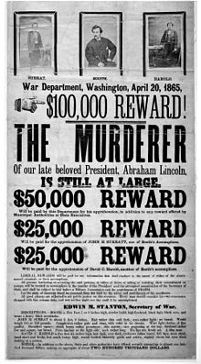
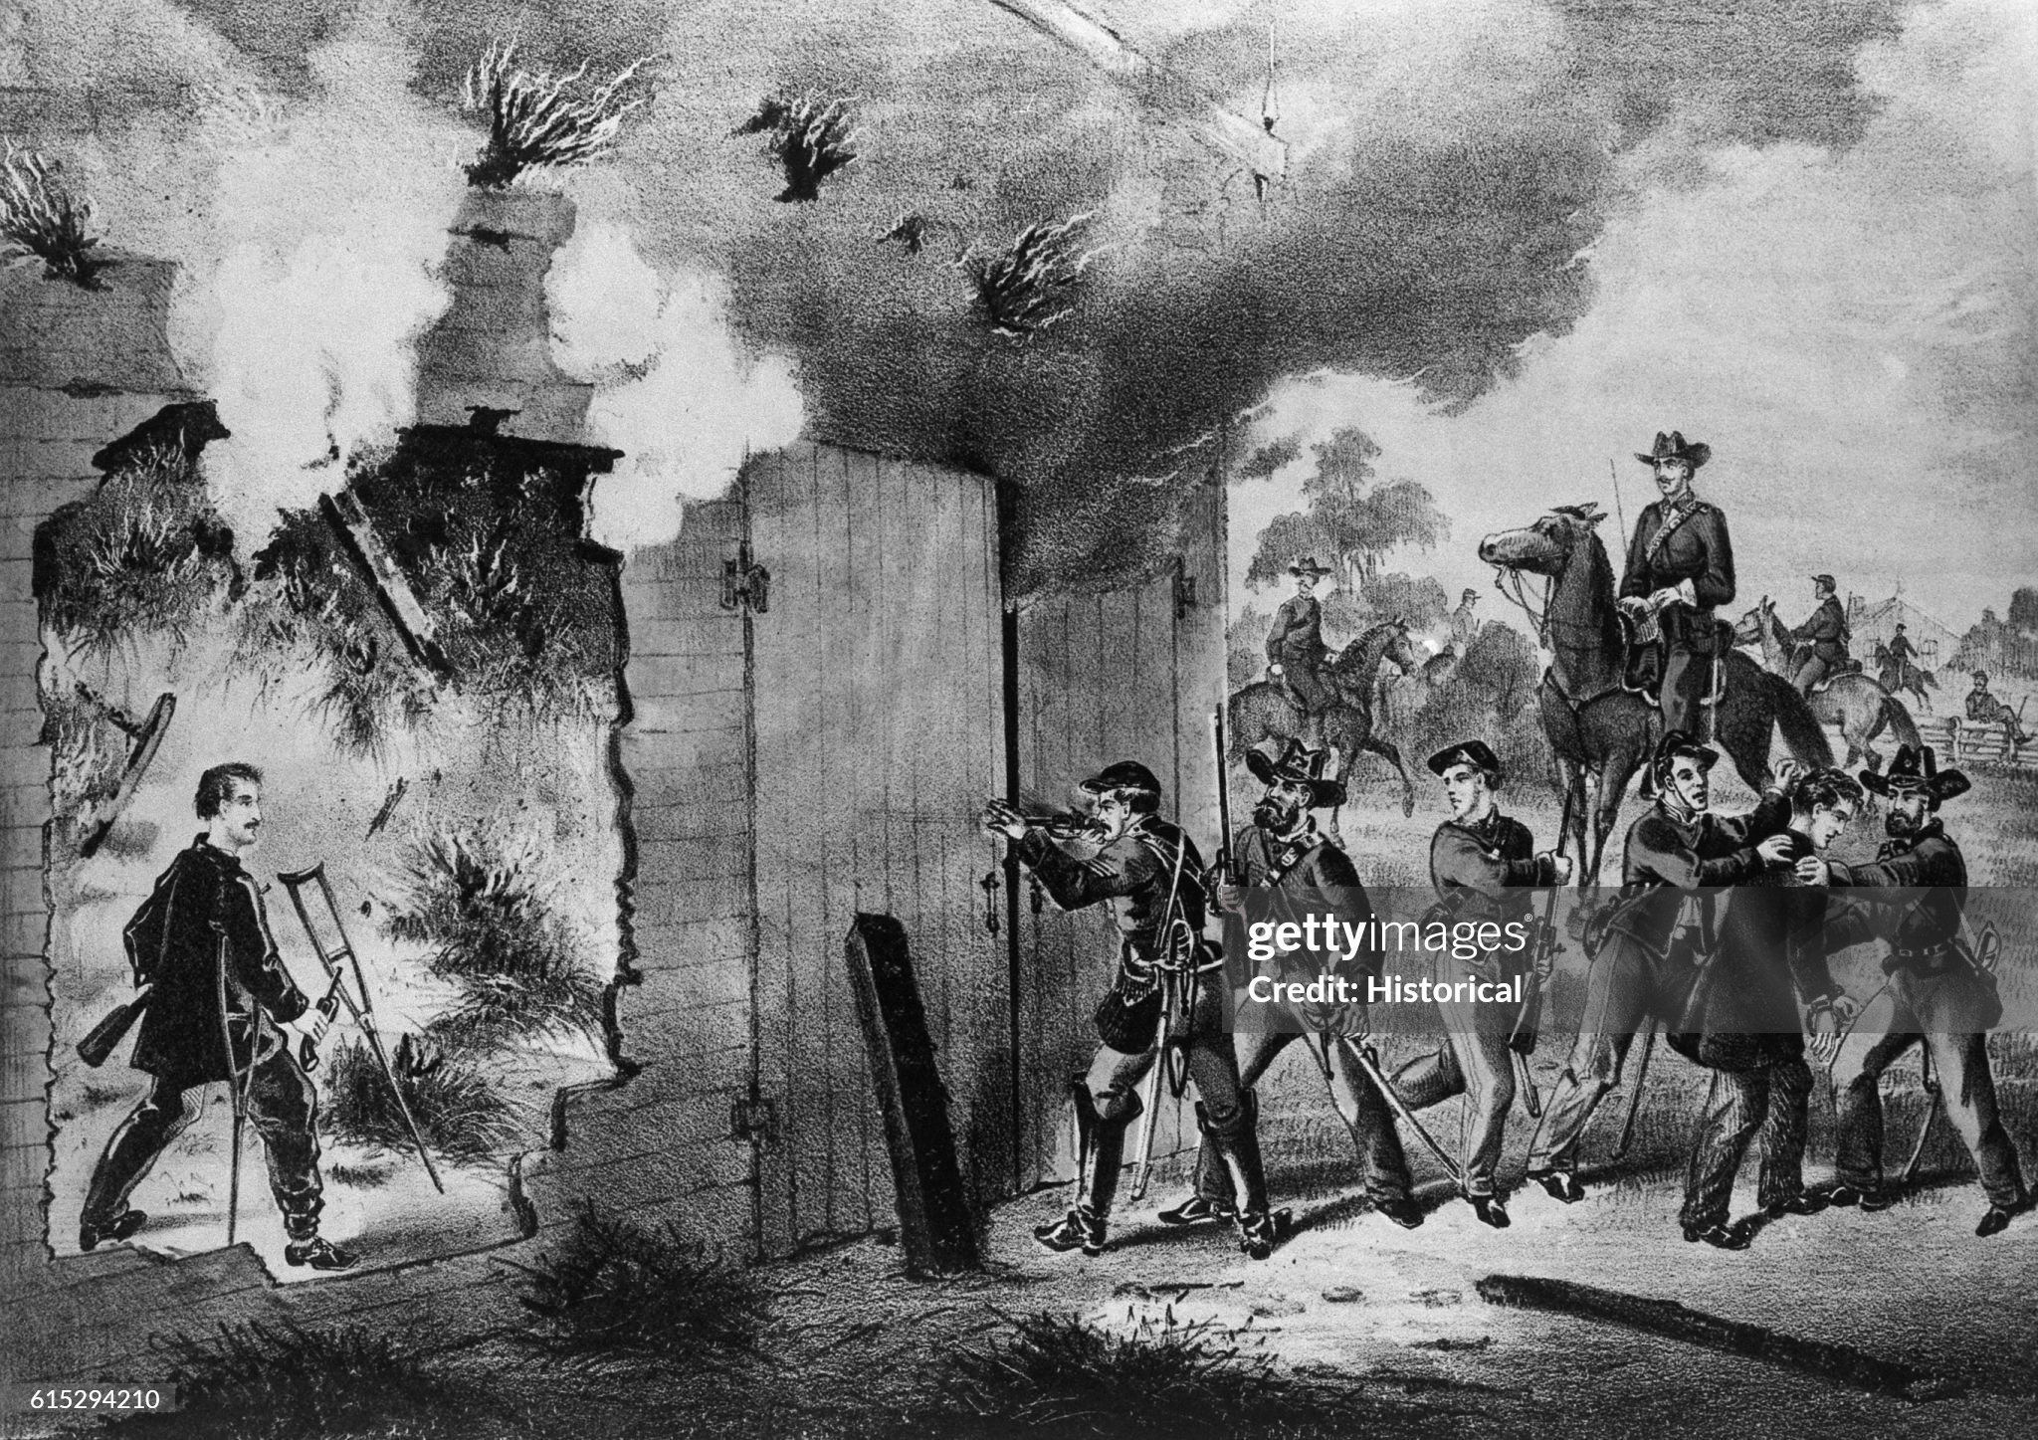
National manhunt
Booth and accomplishes caught…Booth shot
…rest arrested. Military trial.
Reward £3m 2024..

Slide 9
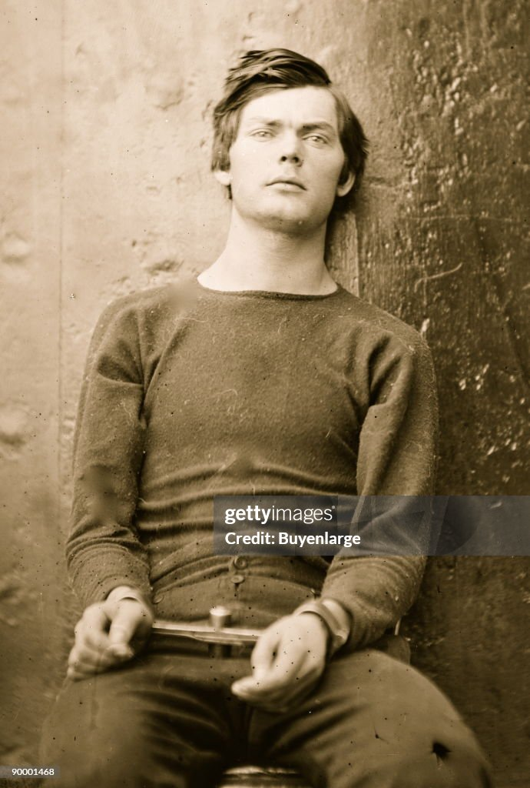
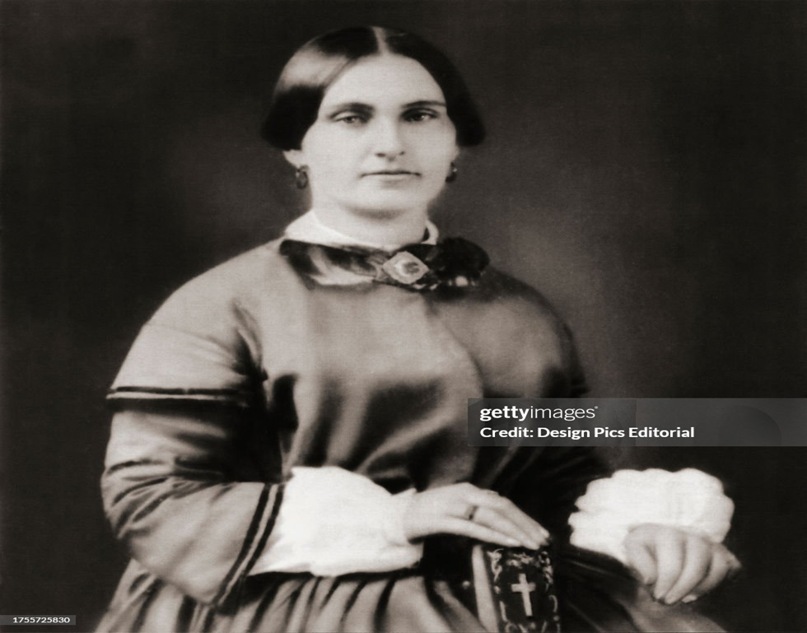
Two accomplices…awaiting execution
Lewis Paine (Confederate
Soldier, Gettysburg, raider, moved
To Washington for assassination
Mary Serrat (unmanacles ) jury recommends clemency
….accused of delivering gun to Booth
…claims innocence…..Lewis attest innocence on scaffold.

Slide 10
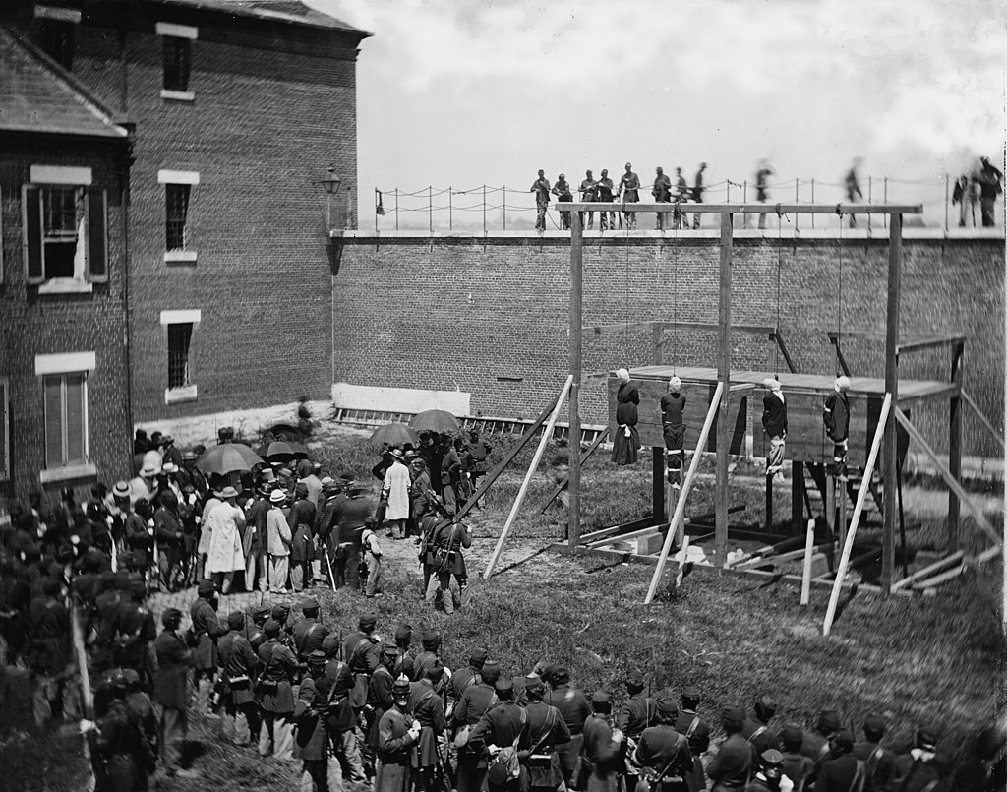
Conspirators executed July 7, 1865

Slide 11
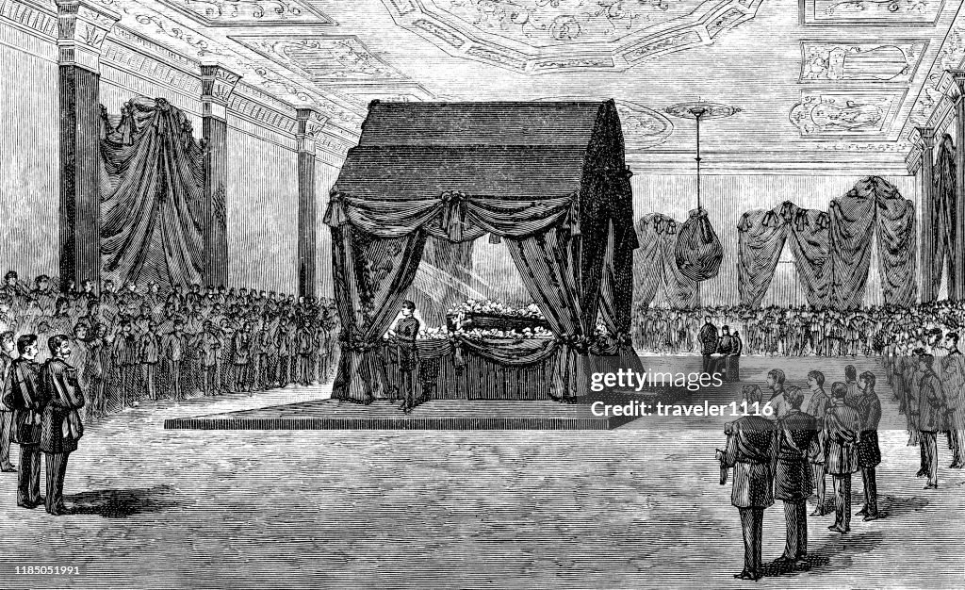
Lincoln lying in state

Slide 12
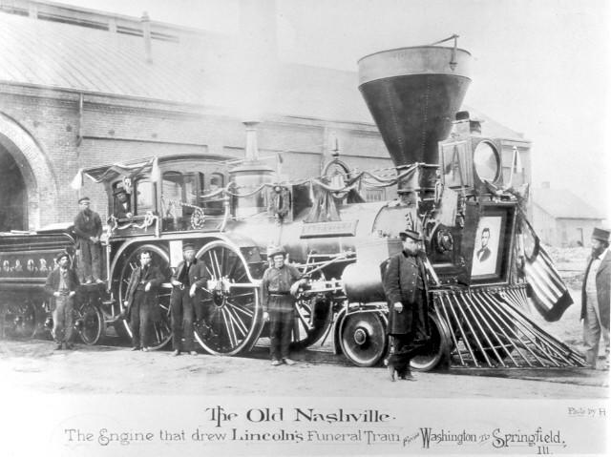
Funeral Train from Washington to Illinois …tens of thousands lining route

Slide 13
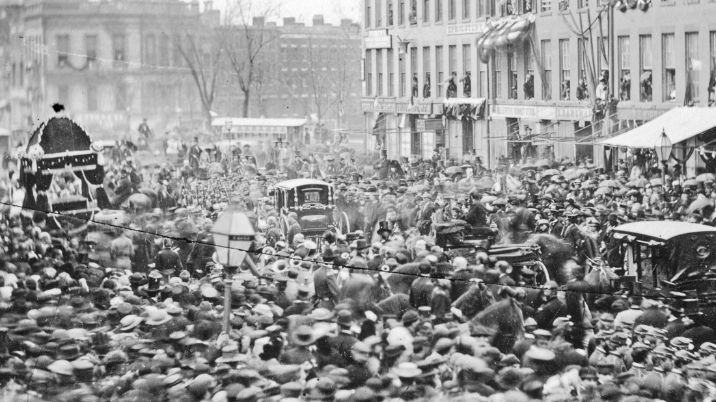
Funeral parades through cities enroot …..Buffalo New York

Slide 14
Aftermath of assassination
Mass national grief….body taken by train across North….parade every town
South is not blamed
Quick arrest of conspirators
Public trial and execution
Former Southern generals and leaders quick to condemn assassins
Vice President Andrew Johnson assumes Presidency
Many questions….no authoritative voice to answer them

Slide 15
Questions in need of an answer
What should be done about the Southern Leaders?
Should Southern states by abolished, if returned to Union how & when
What to do with Southern debts….many with slave values as collateral?
What to be done about the 4 million blacks now free?
If not slaves, what?
To what extent should they have rights?
What about voting?
How to resolve International issues?
French Empire in Mexico a threat to US North American domination
Anger at British decision to build and supply Confederate warships

Slide 16
Reconstruction 1863-1868

Slide 17
Reconstruction prior to 1865
Union army begins occupying large areas of South from 1863
Some generals redistribute land to slaves (promised 40 acres + mule)
Freed slave join northern army
Emancipation Proclamation of 1863 now law of land
Slavery to be abolished in seceding states (not in Border States)
No compensation to owners
Lincoln policy : Southern states readmitted when 10% resident sign “Iron Clad Oath”
Homestead Act 1862 …provided free land in West for all..if developed
Many former slaves migrate West to secure independent life )
Creation of “Freedman’s Bureau” to facilitate transition of slaves to freedom

Slide 18
South 1865
Mass death &suffering
25% white males between 20 and 40 killed (290,000) killed, 300,000 wounded…many for life
750,000 young men returning from war, armed, farms in runs, humiliated
Social and Economic system destroyed
Basis of wealth (Value of slaves) reduced by 60%
Leadership class barred from politics
Occupied by northern army 500,000 strong
Many cities destroyed, plantations burned, railways in ruins, farms neglected
Fear of slave revolt/ revenge…blacks 40% to 60% most Southern state population (less than 1% north)
4 million blacks in limbo
190,000 with military experience
Most illiterate, no experience wage economy, self management
Lifetime spent living within a mile of farm or plantation
Many move to cities to escape ….with no work, means of support

Slide 19
Diary of a Slave Owner (William Revenal May 30,1865)
“My Negroes all express a desire to remain with me. I am gratified at the proof of their attachment. I believe it to be real and unfeigned.
For the present they will remain, but in course of time we must part, as I cannot afford to keep so many, and they cannot afford to hire for what I could give them. As they have always been faithful and attached to us, and have been raised as family servants, and have all of them been in our family for several generations, there is a feeling towards them somewhat like that of a father who is about to send out his children on the world to make their way through life.
Those who have brought the present change of relation upon us are ignorant of these ties. They have charged us with cruelty. They call us, man stealers, robbers, tyrants. The indignant denial of these charges and the ill feelings engendered during 30 years of angry controversy, have culminated at length in the four years war which has now ended. It has pleased God that we should fail in our efforts for independence and with the loss of independence, we return to the Union under the dominion of the abolition sentiment.
The experiment is now to be tried. The Negro is not only to be emancipated, but is to become a citizen with all the right and privileges! It produces a financial, political and social revolution at the South, fearful to contemplate in its ultimate effects. Whatever the result may be, let it be known and remembered that neither the Negro slave nor his master is responsible. It has been done by those who having political power, are determined to carry into practice the sentimental philanthropy they have so long and angrily advocated. Now that is fixed. I pray God for the great issues at stake, that he may bless the effort and make it successful - make it a blessing and not a curse to the poor Negro."
Freedman’s Bureau and American Missionaries move in….

Slide 20
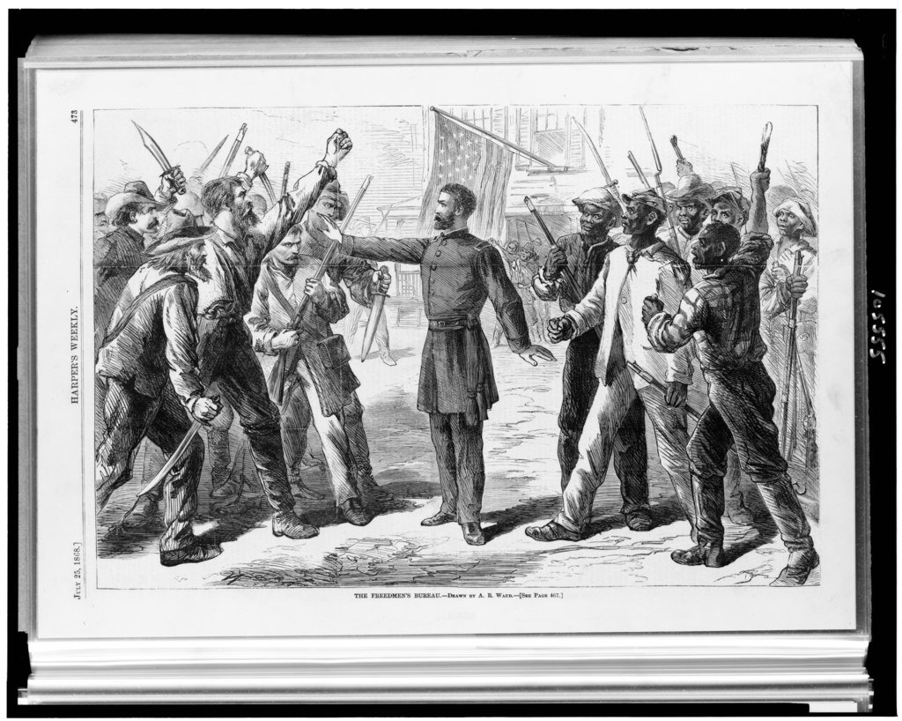
Freedman’s Bureau 1865-1866
Member, Abolitionists
Missionaries, former soldiers Women seeking chance to do
good and live independently ….’a crusade for improvement
……move South
Issue aid, rations
Create labour contracts
Create schools for
Children, technical
Colleges for adults
Resolve legal disputes
Issue marriage certificates
Re-unify mother’s with
Children sold as slaves

Slide 21
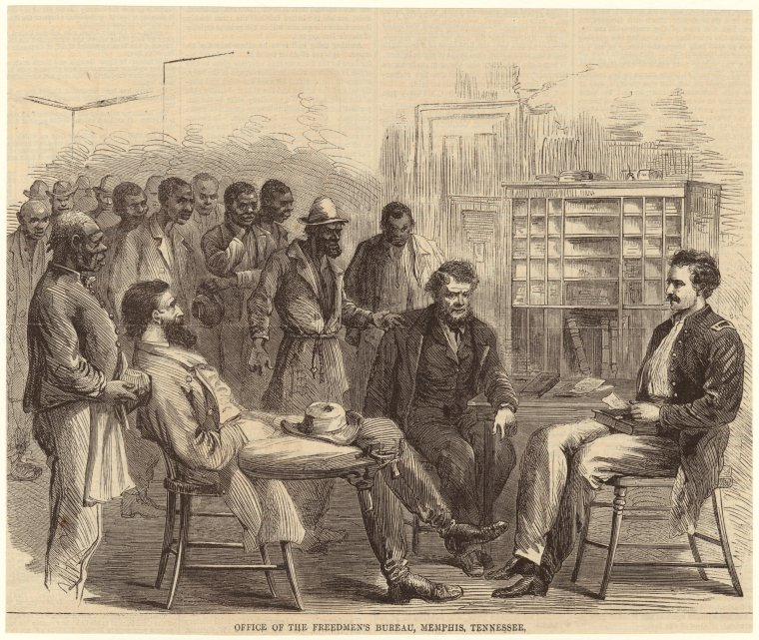
Freedman’s Bureaus in action 1866

Slide 22
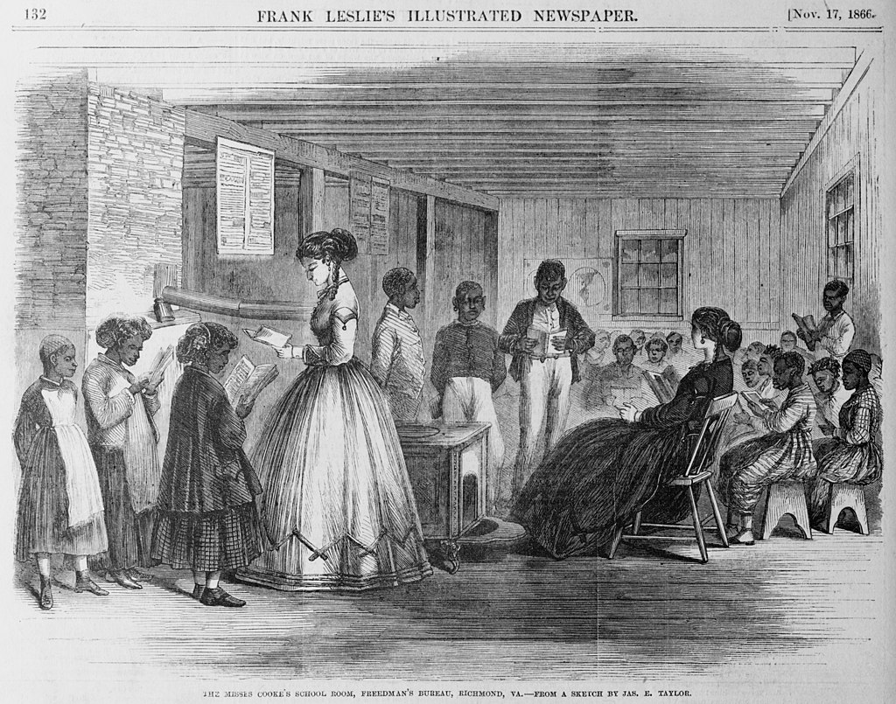
First schools for black children

Slide 23
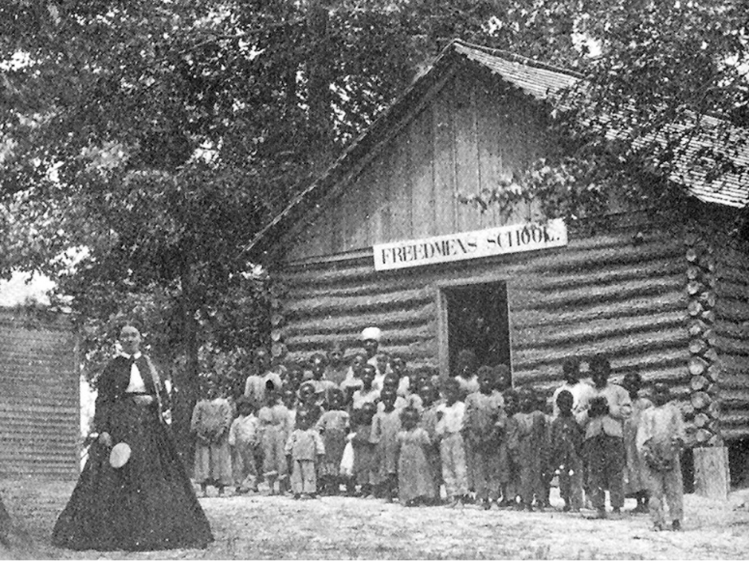
Freedom School 1868

Slide 24
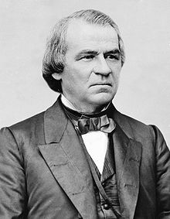
Andrew Johnson (1808-1875)
Poor background, never attended school
Former indentured servant then tailor
Taught to read by wife, bibliophile,, studies
Great speeches, real estate speculator
Enters state politics for 10 years …buys slaves…
Whig … Democrat…US Senator…Governor of
Tennessee, pro slavery, stays with Union in
1861…For the “poor white”
hates Southern aristocrats…and blacks
“Damn the negroes, I am fighting those traitorous
aristocrats, their masters,"
Logical choice to balance 1864 ticket and win
Northern Democrat vote ..only loyal Southern Senator
….. succeeds Lincoln April 1865

Slide 25
Johnson & Reconstruction of South
Goal: destroy Planter Class and raise up poor whites
Southern leaders must request “Pardon” direct to President to re-join politics
All debts made by South to bond holders & foreigners eliminated
Poor indebted whites freed from slave mortgages
South is to be redeemed, not reformed
Southern states to approve 13th Amendment abolishing slavery
To be ‘readmitted” when 10% of resident sign “Iron Clad Oath”
Reduces Army of occupation from 500,000 to 40,000 by 1866
Blacks to remain subservient
Land scheduled for redistribution returned to owners (no 40 acres and a mule)
Tries to defund Freedman’s Bureau…blocked by Republicans in Congress
White Southern politicians (after taking oath) to retain control

Slide 26
Southern Reactions
“Black Codes”
New laws to define “vagrancy” and limit freedom of movement
State Approve 13th Amendment ”Neither slavery nor involuntary servitude, except as a punishment for crime where of the party shall have been duly convicted” …
Use “crimes” to re-enslave blacks leaving plantations and moving to cities….unable to find work
Establish convict penal systems
Freedman’s bureau made powerless
Johnson cuts funding
Army reduced from 500,000 to less than 50,000
Southern backlash supported by propaganda and Klu Klux Klan

Slide 27
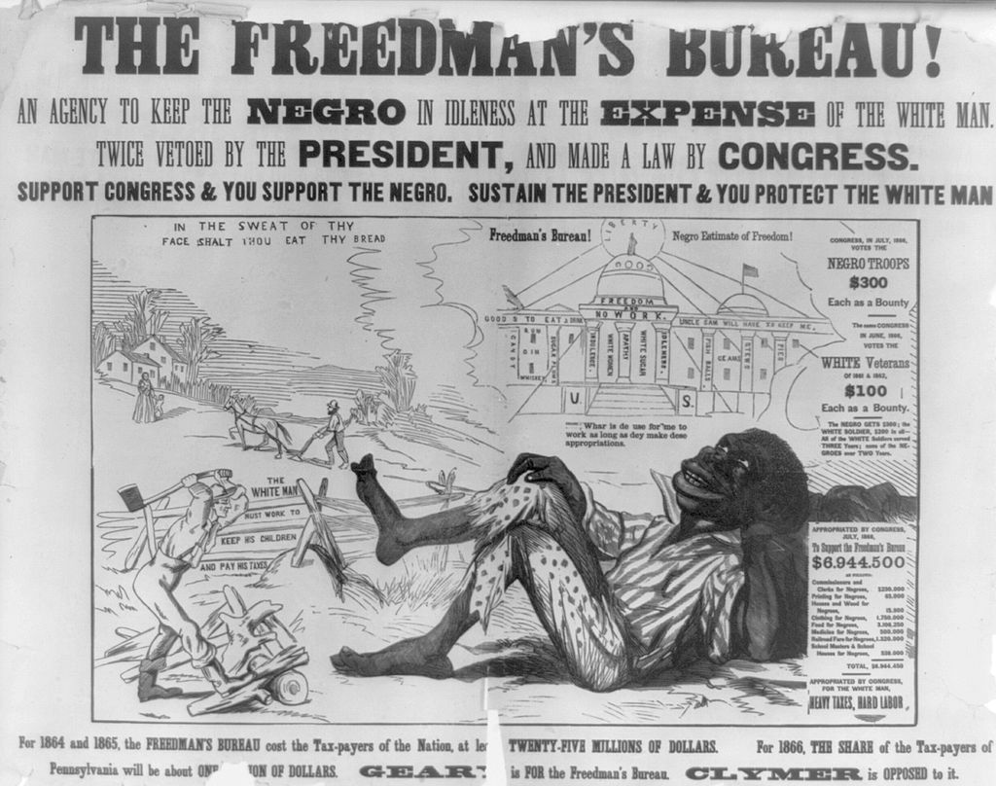
Anti Freedman's Bureau Propaganda

Slide 28
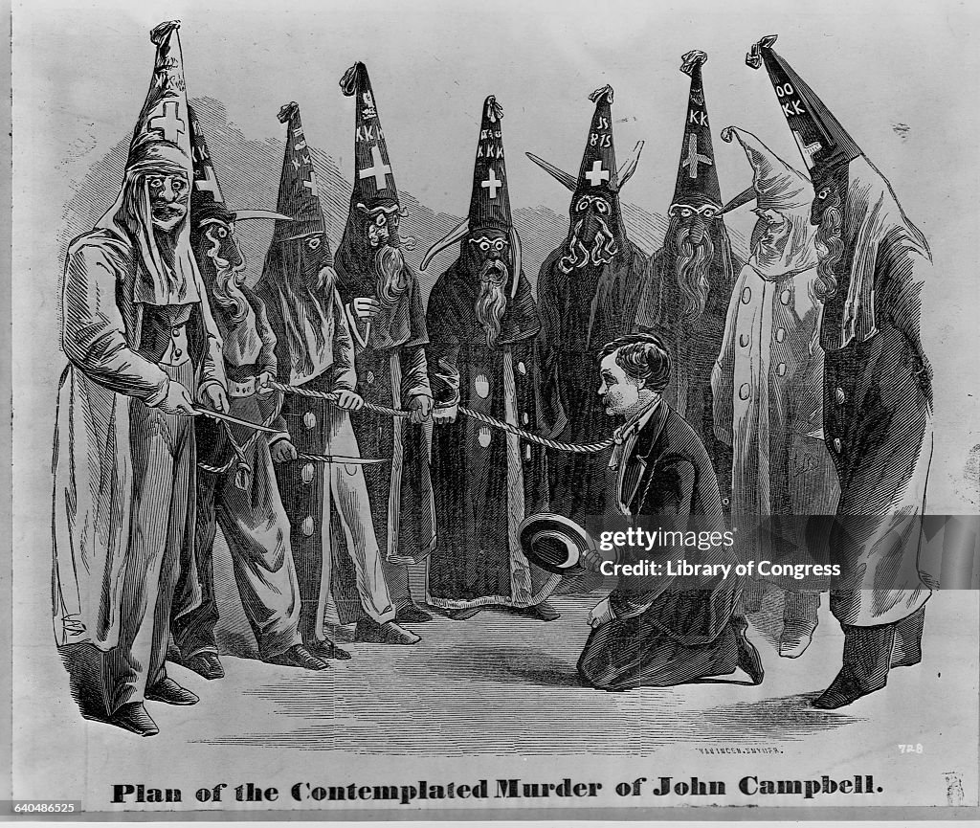
Klu Klux Klan
Secret society of Ex Confederate officers
(kuklos (Greek ..circle) Klan
(Clan)…imitate Masons, Knight
of Malta)..
formed 1866..Initially ‘men’s club’….becomes
Anti black, catholic, and Jews
Targets Freedmen members
Teachers at black schools.
Politically active blacks
Multiple murders….beginning
Of “lynch law”…whites and
Blacks murdered

Slide 29
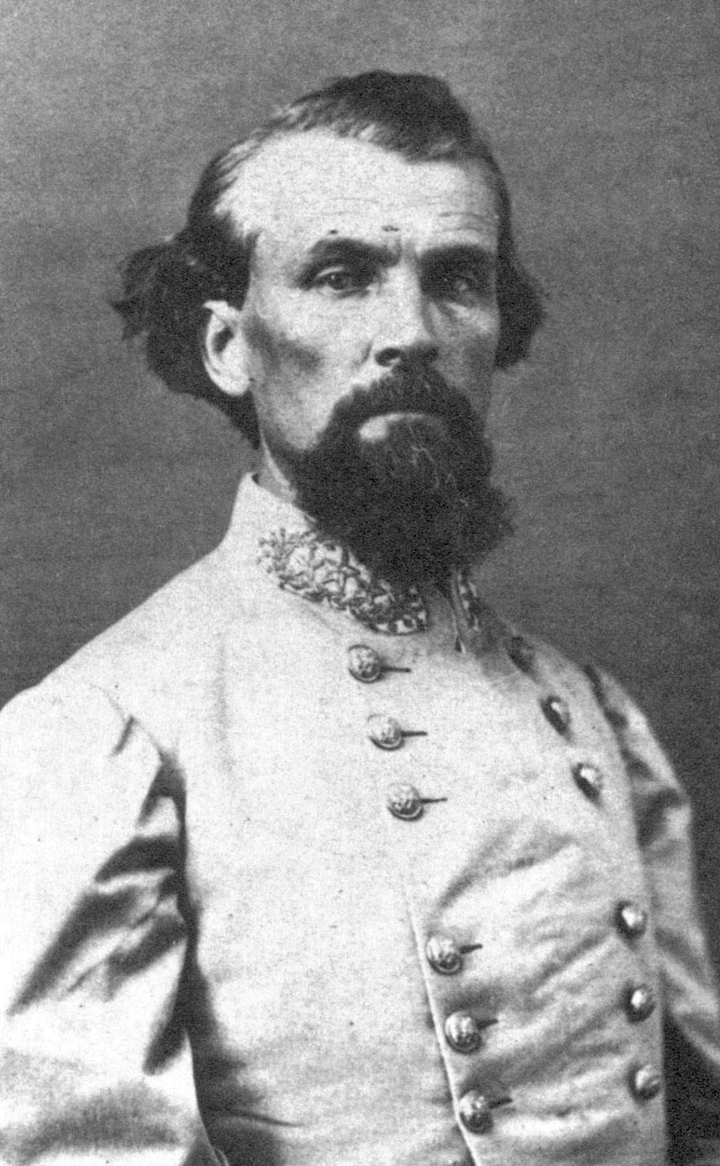
Nathan Bedford Forrest (1821-1877)
Gambler, slave owner Real estate speculator And cavalry officer for Southern army
Brilliant strategist vs great odds…rises to head of guerrillas in Border States
Captures Fort Pillow on Mississippi 1864 ..garrisoned by mostly black troops …surrender…300/400 bayoneted
…Forrest implicated, denies
Elected head of Klan 1867
Claims 500,000 members across South ….. Intimidation/ killings of hundreds
….most killings undocumented
“Born again” during 1870’s sees redemption by supporting black self Improvements. Mourned by blacks on death

Slide 30
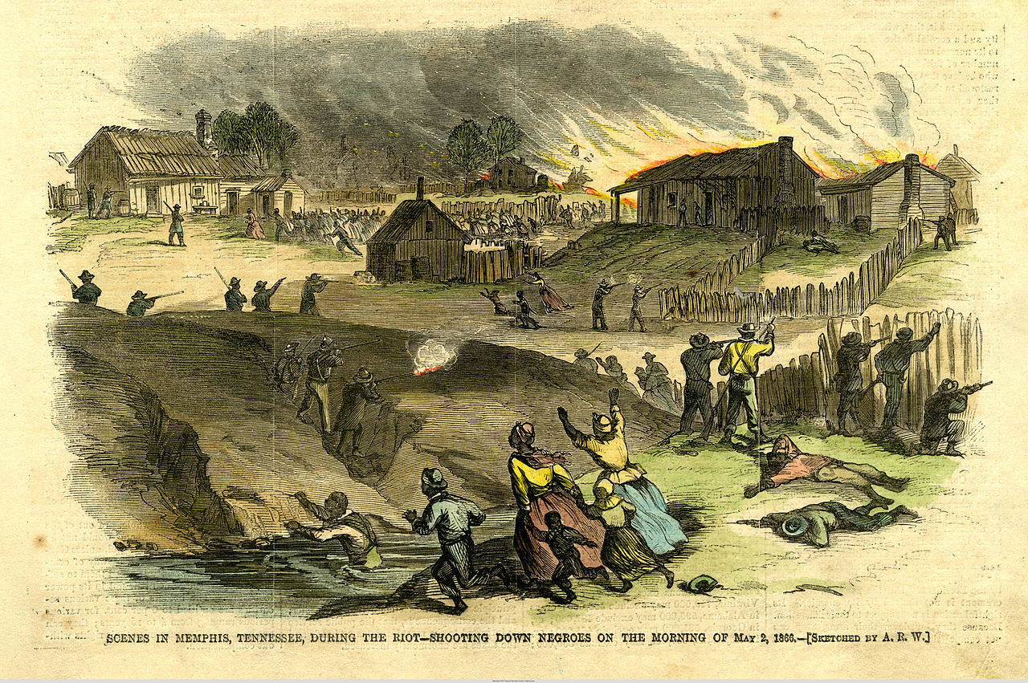
Memphis race riot May 1866
Whites collude with soldiers to consign Black school children to forced labour
…income supplement?
Freedman Bureau agent: “How is it that the
coloured children in Memphis even with
their spelling books in their hands are
caught up by your order & taken to the
same place & there insolently told
that they 'had better be picking
cotton?'
Irish immigrants (50% of city) threatened
By cheap labour…riot…Army refuses
To intervene, suggest posse
Mob attacks, burns new schools, selects
Victims based on surbserviene..50 blacks
2 whites die (one white by whites. Talking
To black friend….no arrests

Slide 31
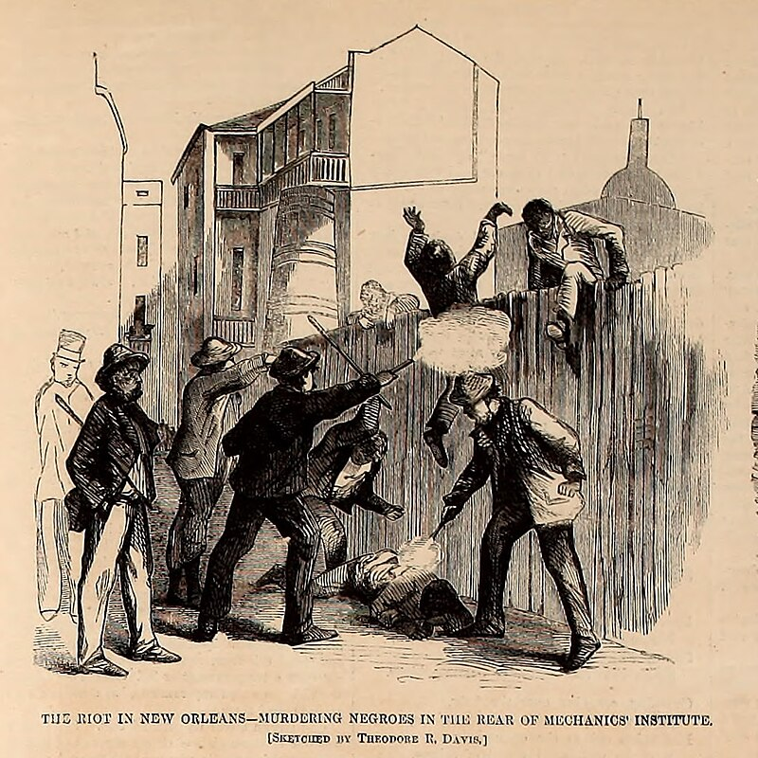
New Orleans Race Riots July 1866
New Orleans occupied since 1862…Republicans Organise Convention for 1866 mid terms and end “martial law! many
Blacks already free, Educated, attend and vote biracial list of
candidates
White mob attacks parade
after convention…mow down
Delegates, form all White govern
Men …200 murdered
…army declares martial law &
.removes local white officials
President Johnson supports riot
Orders removal of troops and
Supremacy of “states rights”

Slide 32
Rise of Radical Republicans and Johnson
Northern press enraged by events in South
South reverting to form…”States rights” > “National Laws”
400,000 Northern deaths for ‘nothing’
Convict leasing seen as slavery by another name
Klu Klux Klan the new rulers of the South
1866 Mid-Terms
Republicans secure overwhelming majority in Congress
Resolve to remove power from President Johnson
Refuse to accept South delegates
Seize control of Reconstruction
Leader Thaddeus Stevens

Slide 33
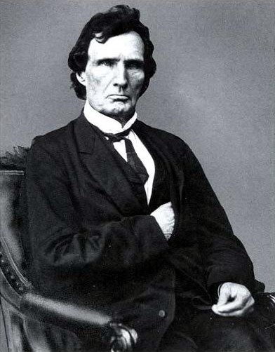
Thaddeus Stevens (1792-1868)
Vermont lawyer. Abolitionist, moves to
Pennsylvania, Former Wig> Know Nothing
….never marries…secret relationship light skinned
free African American woman
Joins Republicans 1859 .elected to Congress
Wants black equality, confiscation of
Property from slave owners, universal male
Suffrage, free public education
Elected Congress 1859, leads Ways & Means
Committee to finance war….rises to prominence
Argues with Lincoln for radical change. Lincoln
“Stevens, this is a pretty big hog we are trying
to catch and to hold when we catch him.
We must take care that he does not slip
away from us.”
Leads efforts to pass “Reconstruction Act”
1867…constitutional amendments and
Impeach Johnson

Slide 34
Radical Reconstruction
Civil Rights Act 1866 …Johnson vetoes , Congress overrides veto
Reconstruction Act 1867
Resumes funding of Freedman's Bureau
Expanded to include pension and savings for black workers
Re- imposes Martial Law
Tenure of Office Act 1866 …President cannot fire head of Freedman’s Bureau
Constitutional Amendments…states must pass before readmitted….
14th Amendment – all US born and naturalised. Federal not state defined
15th Amendment.. Guarantees right to vote to citizens

Slide 35
Johnson Response & Impeachment
Meets with Frederic Douglas
Douglas wants extension of franchise
Johnson will undertake mass deportation of blacks to Africa unless they comply with “Black Codes”
Confides to aide “Those damned sons of bitches thought they had me in a trap! I know that damned Douglass; he's just like any nigger, and he would sooner cut a white man's throat than not.”
National tour during 1866 mid-terms to replace Radicals
“If blacks were given the right to vote, that would place every splay-footed, bandy-shanked, hump-backed, thick-lipped, flat-nosed, woolly-headed, ebon-coloured in the country upon an equality with the poor white man”
Describes self as Moses to blacks …will deliver “Promised Land” if they accept subservience
Responsibility of Whites in each state to decide life of blacks (“States Rights”
Fires Head of War Department ( & head of Freedman's Bureau)…breaks Tenure of Office Act
.
Impeached 1867….keeps Presidency by one vote

Slide 36
Election of 1868: the Candidates
Republicans
Unanimously pick Ulysses Grant…civil war leader runs as “Radical Republican”
Grant makes no public speeches
Campaign peace and reconstruction of South
Blacks vote across South for first time
Democrats
Dump Andrew Johnson
Texas, Virginia
Picks Governor of New York …run as “White Man’s Party”

Slide 37
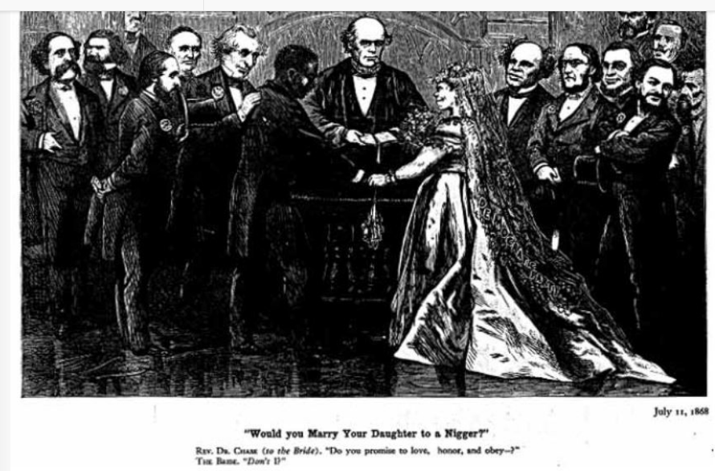
Democrat 1868 Campaign

Slide 38
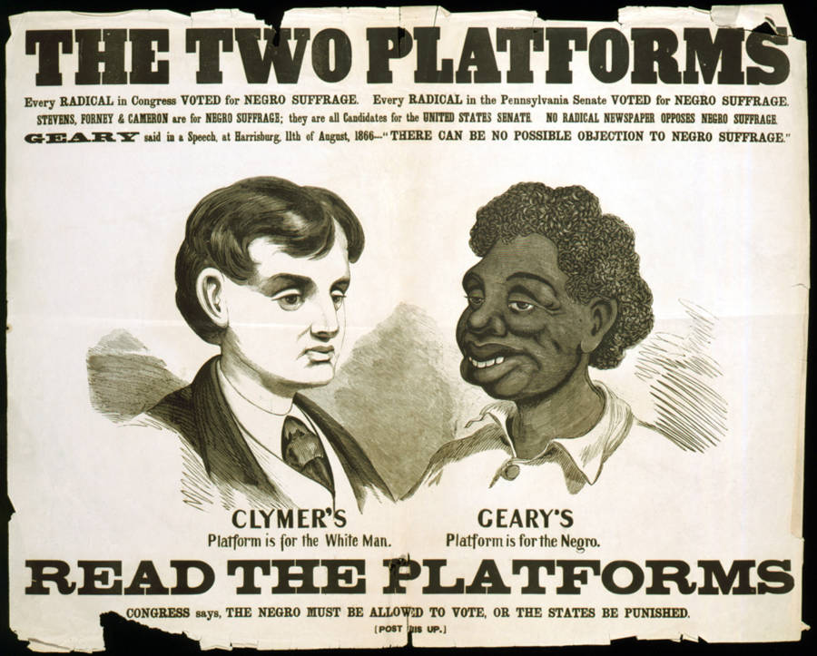
Democrat racist cartoons vs black suffrage

Slide 39
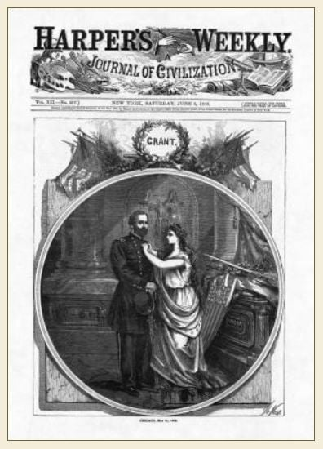
Grant: Peace, Prosperity, Progress, decency

Slide 40
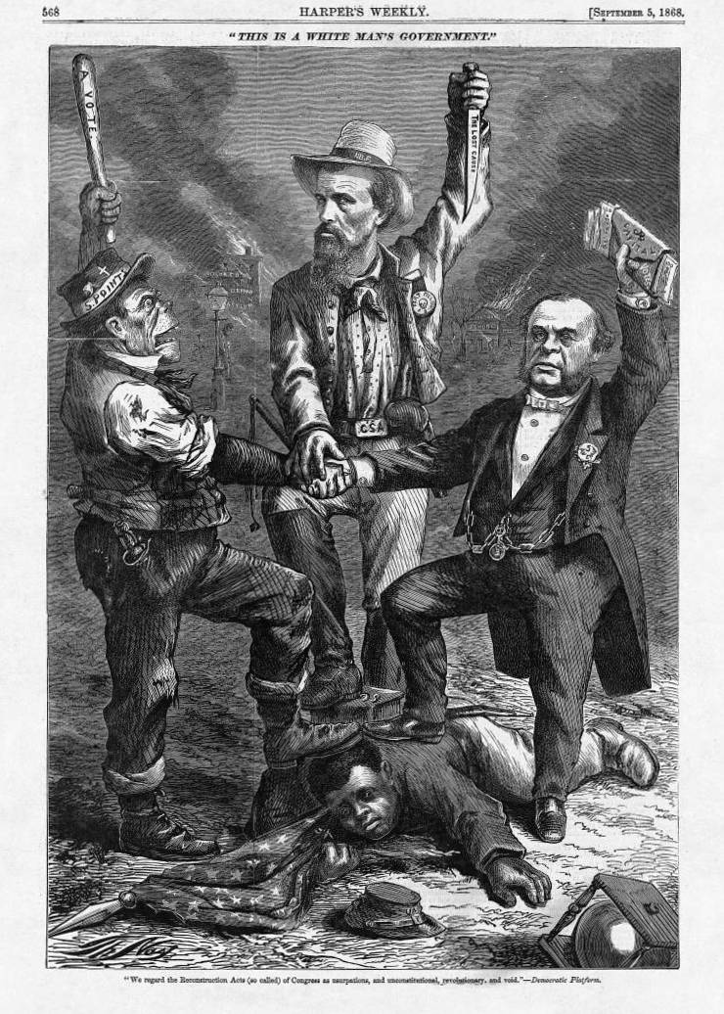
Republican election cartoon: Johnson, Irish immigrant, Southern soldier stamping on loyal black soldier

Slide 41
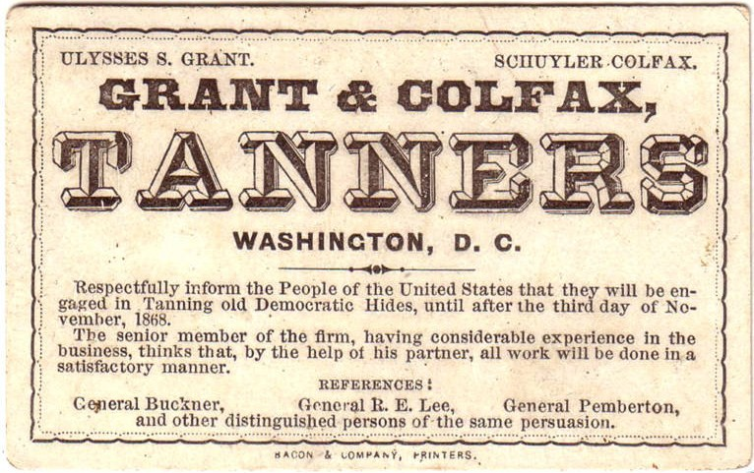
Grant campaign…..appeal to honesty…

Slide 42
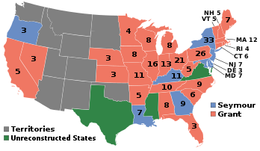
1868 Election Results
Grant wins 53% vote, vs
47% Democrats, 217 electoral
Votes vs 80)…majority of only
300,000…5.7 million votes
Blacks able to vote across most
Of South…500,000 vote for
Republicans…wins Alabama,
Carolinas, Tennessee…and election
Texas, Mississippi and Virginia
Not yet readmitted into union
Grant & Republicans dependent
On black vote…

Slide 43
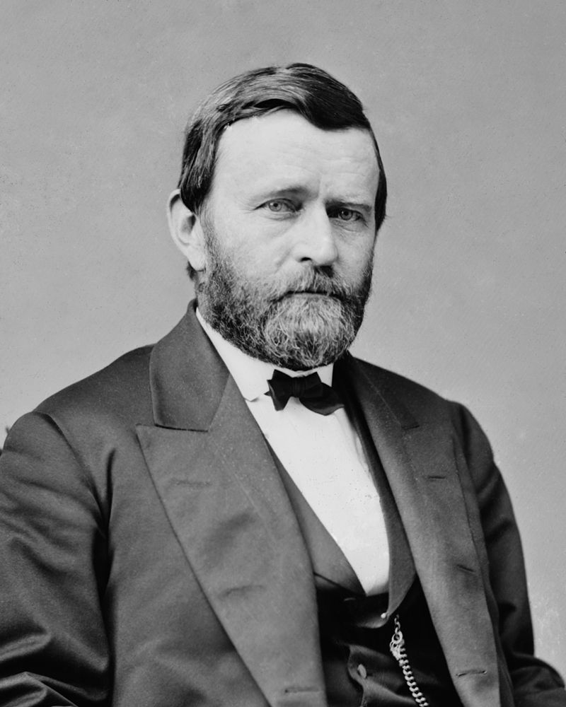
Ulysses Grant President 1869-1877
Grant aged 46…youngest President to date
Supreme Union Commander
…failed businessman before/ after war
…places trust in affluent ‘friends’
Persuades France to abandon
Mexico…..troops leave, Emperor
Does not…pays price
Negotiates settlement with Britain
For damages caused by ships
Built for Confederacy
Passes “Klu Klux Klan Act” use army
to crush Organisation, 500 arrested,
…disbanded
Integrates Postal Service,
Blacks enter national and local
Politics for the first time..14th, 15th Amendments approved

Slide 44
Radical Reconstruction 1868-187

Slide 45
Black political representation 1868-1877
National Government
2 Senator (out of 80)
7 Representatives ( out of 300)
Literate, educated, articulate: Senator observed: “The coloured men who took their seats in both Senate and House were as a rule studious, earnest, ambitious men, whose public conduct would be honourable to any race."^{[20}
Local Governments
Former Confederates prevented from voting
Alliance enfranchised freedmen, white unionists
Blacks assume control of state legislatures in Carolinas, Mississippi, Alabama, Georgia, Virginia
Introduced public education systems…for first time for poor whites and blacks,
Civil rights, infrastructure improvements
Many illiterate, attend sessions with sons reading for them, ill prepared and naive
Dramatically increase property taxes to fund schools, libraries, railways
…..Southern culture low tax, small government

Slide 46
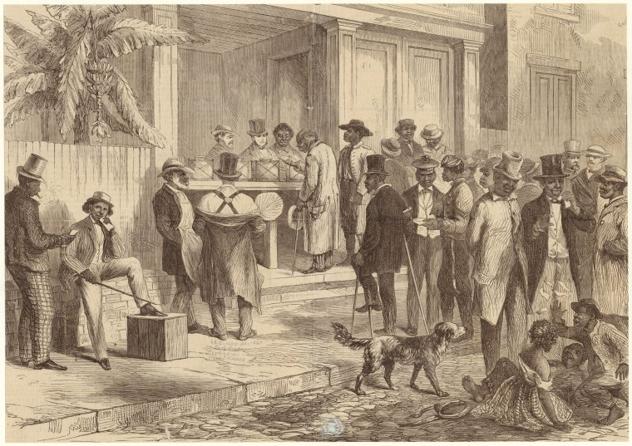
Blacks voting in New Orleans

Slide 47
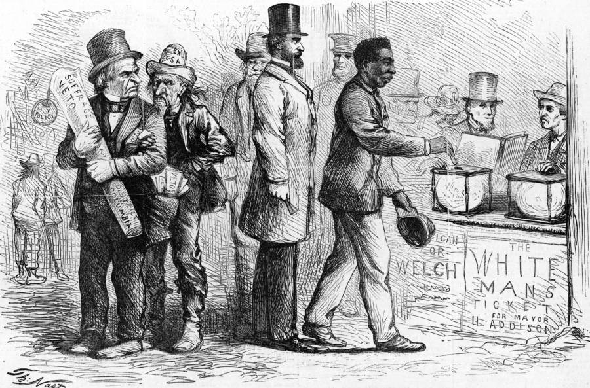
First black voting….Johnson looking on..

Slide 48
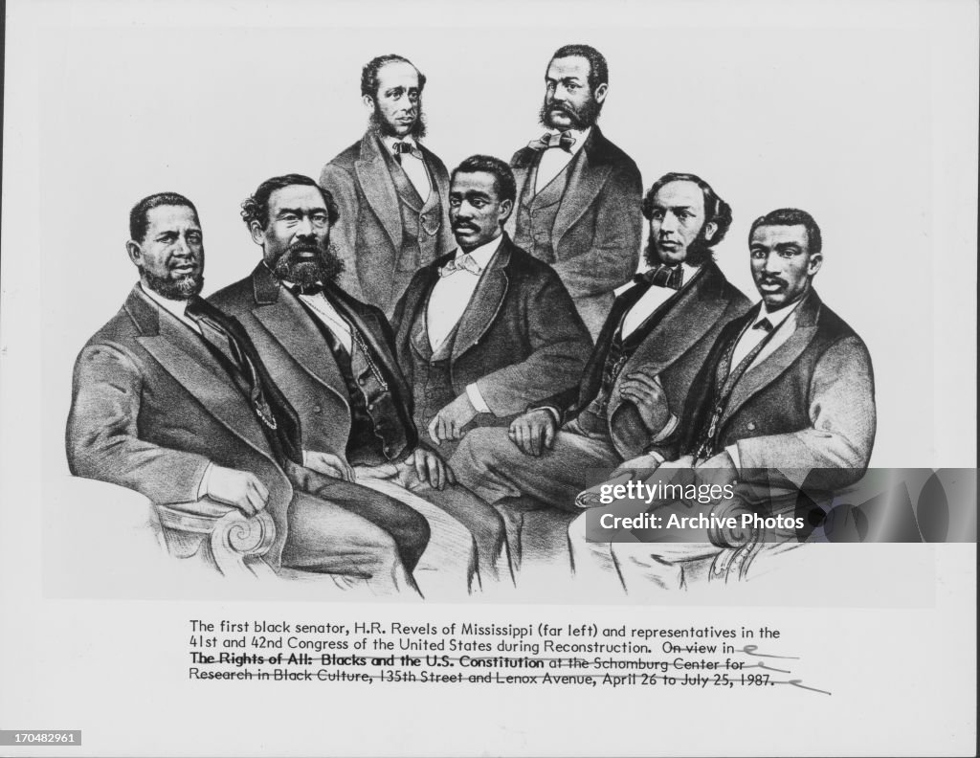
Blacks in Congress!

Slide 49
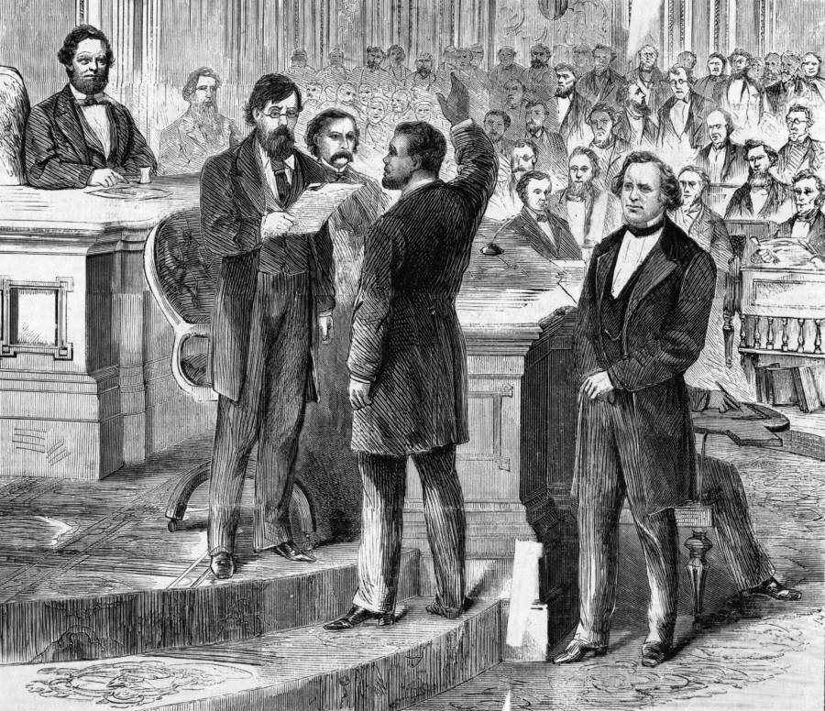
Black Senator taking oath (gallery packed)

Slide 50
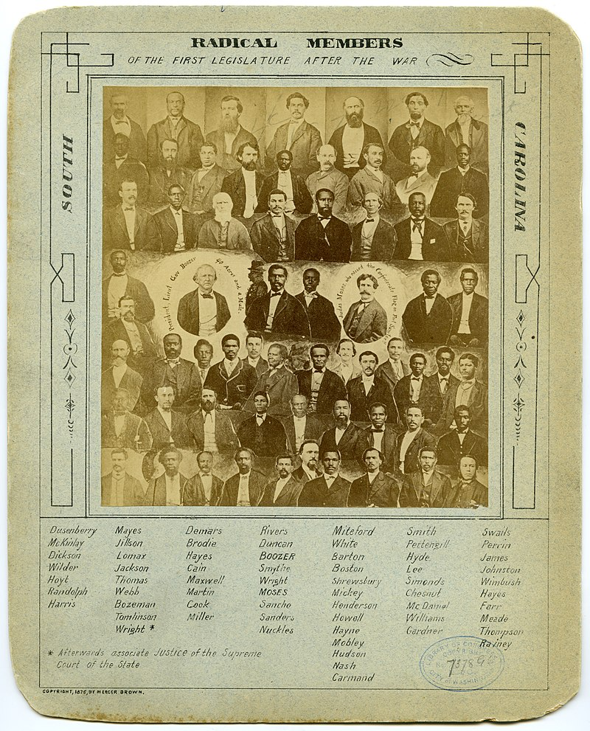
Local Government ….South Carolina integrated” legislature (State 60% black)

Slide 51
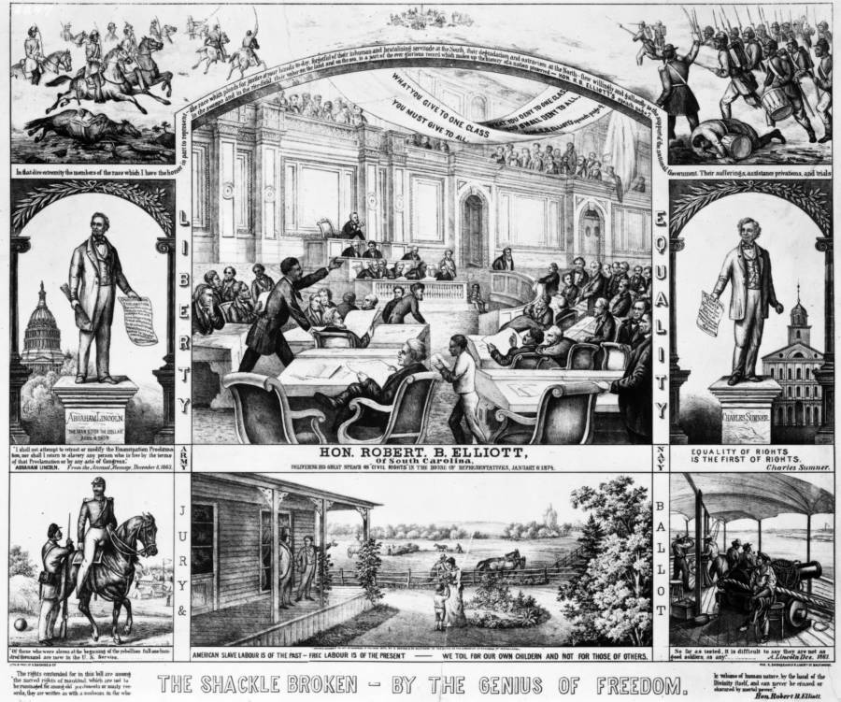
Presence in Southern civil life

Slide 52
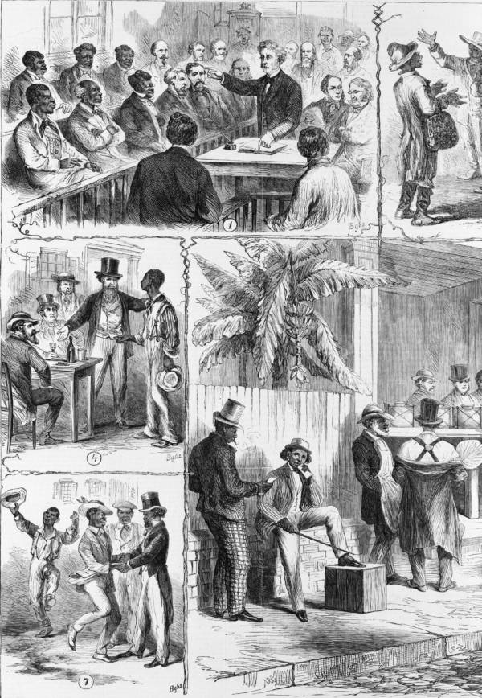
Blacks engage in civil society

Slide 53
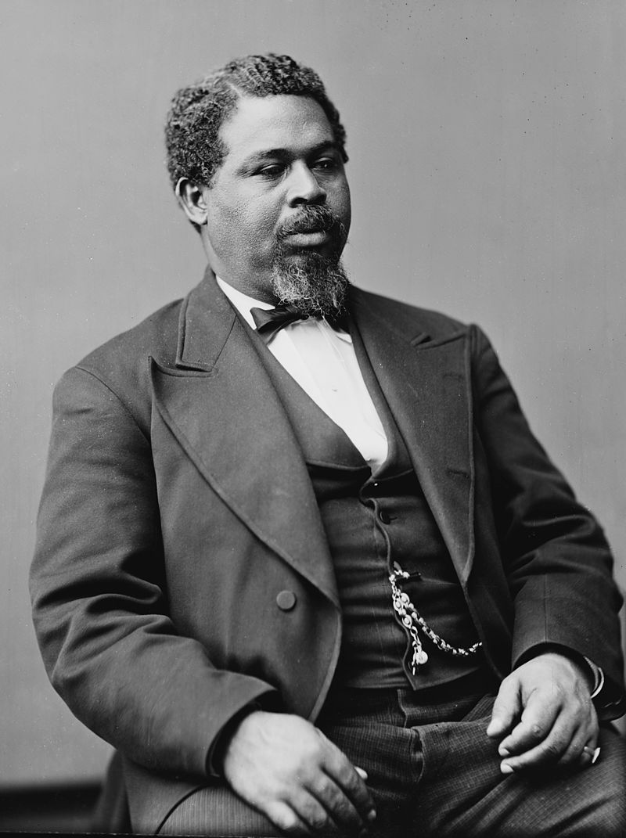
Robert Smalls (1835-1913)
Born slave, rises to being
Pilot of coastal ship. Conscripted
Into Southern navy during war
Commanders ship with wife
And children to Union lines
…fights 17 naval battles during war
…joins Republican party
….Carolina legislature
Elected to Congress.. Serves 2
Terms….fights to retain occupation
Of South…open army to all races
….loses seat 1876

Slide 54
Radical Reconstruction & Southern Life
Change in ownership class
Top 10% of Southern Society lost 90% of their wealth
Replaced by middle level farmers…..and Northern investors (Carpet baggers)
Economic collapse
Labour shortage post civil war….rising price of cotton
Absence of money…Confederate $ worthless, gold/silver rare, limited supply of paper money (Greenbacks)
Solutions ( Liberal Economic world)
Sharecropping
Landowner provides tools, land, directs use of land, crops
Freed slaves provide labour
Receive % of crop when complete less cost of home, tools, support during year
Tenant farming
Tenant pays to rent land….loses
Power returns to land owner….threat to remove lease if unproductive…..or political activity

Slide 55
No longer King Cotton….race to the bottom
Cotton a “commodity” rice of cotton set by demand & International and competition from Egypt and India…increase production during war
The solution….maximise production, depress wages
US Cotton Production 1860-1900
 | Metric tons (000) | Cultivated area (000 hectares) | Yield
1860 | 871 | n/a
1870 | 987 | 3,200 | 308
1880 | 1,151 | 6.700 | 171
1890 | 1,700 | 8.700 | 195
1900 | 2,300 | 10,100 | 227
No significant increase in yield
Owners, tenants, sharecroppers
Condemned to rise/ fall based
On price fluctuations
….and there are many
…..not very “Kingly”

Slide 56
Life of Share cropper
Freed black/ poor white tied to land
Purchases from land owner stores for supplies/ food
Tenancy dependent on yield
Movement restricted….leaving estate = abandonment of contract
Power of debt
Owners identify ‘listed merchants’ to value crop and set prices
Most freedmen illiterate, no access to law
Debts set off to crop yields…data retained by owner
Poor white vs free black
Poor whites lose jobs as overseers/middle men
Blacks in direct competition
Whites seek alliances with new owners…secret societies
Freed black status dependent on Army of Occupation and Freedmen’s bureau

Slide 57
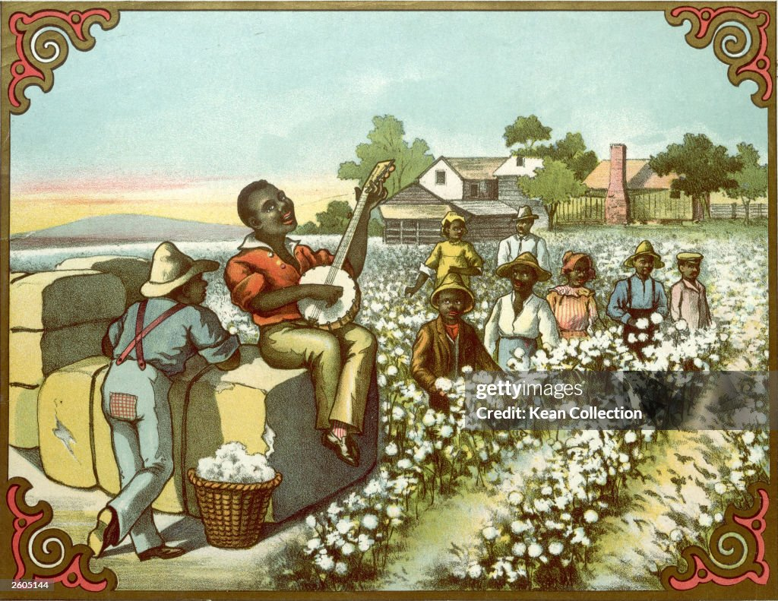
Share cropping….ideal image

Slide 58
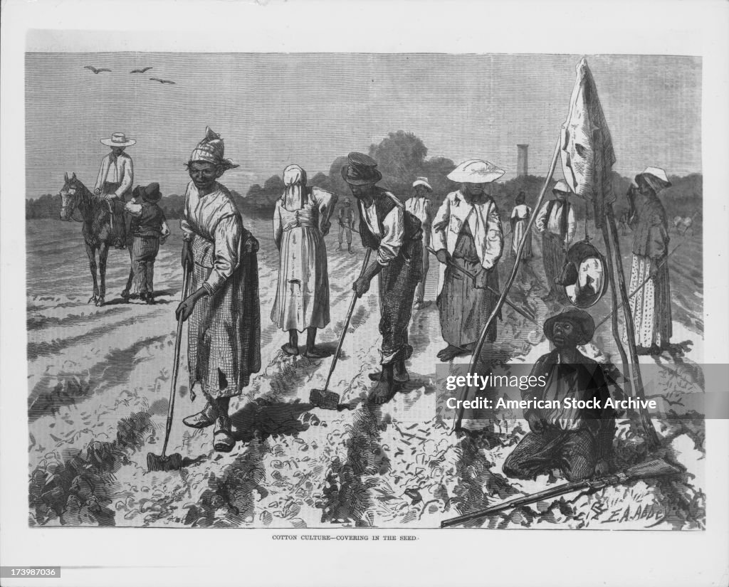
Sharecropping….reality

Slide 59
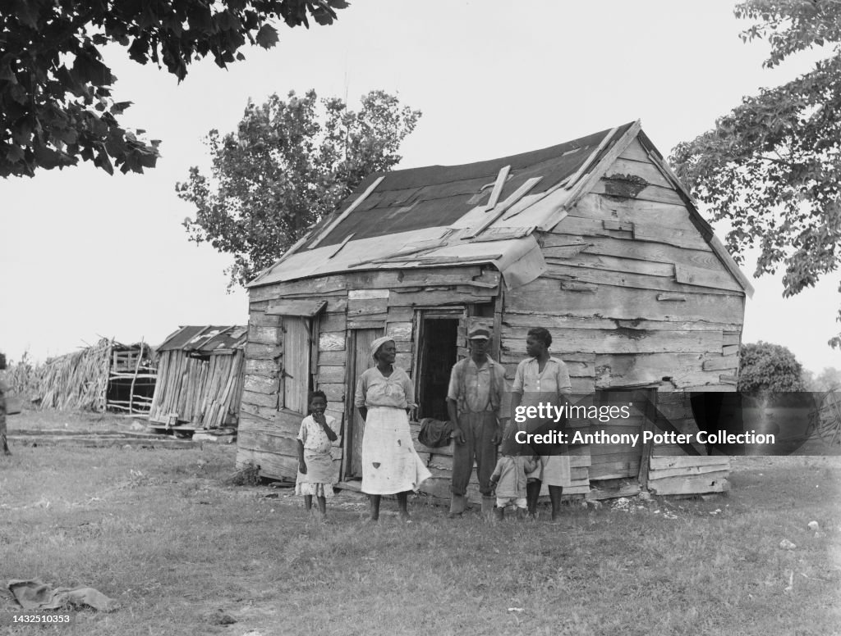
Share cropper home

Slide 60
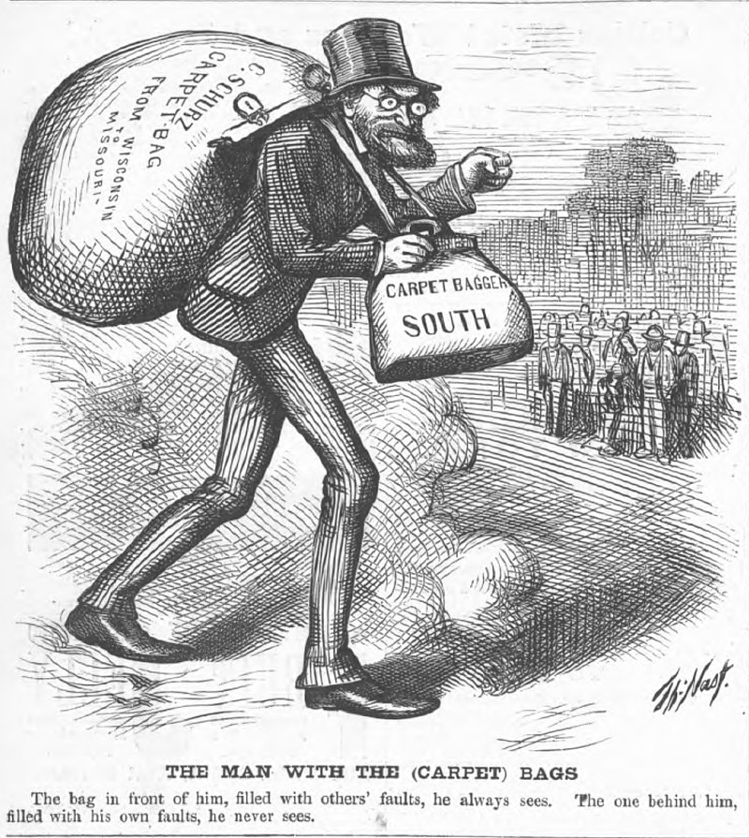
Carpetbaggers & Scallywags
Carpetbaggers: Northern businessmen, former Soldiers moved south to Transform economy: The South a “Better West”
Includes thousands of Northern women teachers for Freedmen's schools
Scala wags (animal of no value)
Southern Unionists seek “new south”
20% white population
Want reform, multi racial society
Carpetbaggers, Scala wages, Freedmen and
Few white Unionists occupy leadership positions in local politics
….former Confederates banned
….new Railroads, public buildings, schools
…many good intentions
Clash of cultures….northern
“Puritan Work ethic”….acceptance of taxes

Slide 61
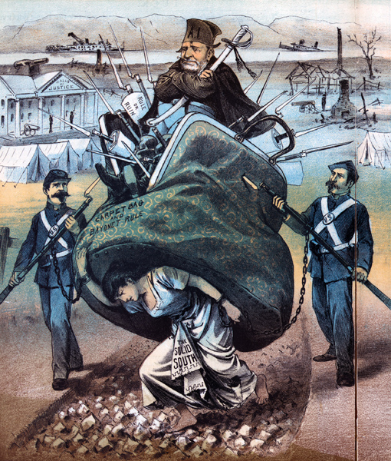
South…filled with resentment ……victimised by Scala wags & Carpetbaggers ……resent status of blacks…Northern troops (many black)

Slide 62
Radical Republicans in retreat
Grant easily re elected 1872 (56% of vote)
Economy collapses 1873
Railroads over expanded and Banks over- lend
Major bank fails…..panic, price of cotton falls 50%
Coinage act demonitizes silver and contracts money supply
Government buys bonds….reducing stock panic but depresses demand
Unemployment rises to 25% in New York, price of cotton falls 50%...
Grant Administration & Radical Republicans discredited
Multiple scandals….embezzlement of state funds
Grant innocent and too loyal towards “friends”
Northern Public see “Reconstruction” as waste of money
Democrats win mid terms 1874…….seek to regain power 1876
……prepared to do anything to restore “White Supremacy”

Slide 63
Rise of para military groups across South
Open, not secret, clear political goals
Removal of Army of Occupation
Closure of Freedman’s Bureau
Intimidate/ murder Republicans, Carpetbaggers, Scalawags, Black Republians
Become “military arm of the Democratic Party” in the South
The White Man’s League: Louisiana
Former Confederate soldiers based in Louisiana
Marches and drill openly (unlike KKK) to intimidate blacks and Republicans
Program of assassination and mass murder
Red Shirts: Carolinas

Slide 64
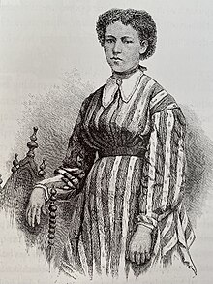
Julia Hayden (1857-1874)
African American schoolgirl
Leave home in Tennessee to
Teach at Freedman’s Bureau
School Louisiana
White Mans’s league breaks
Into her boarding house
And kill her
Killers identified but released
Without trial

Slide 65
Colfax Massacre of 1873
Disputed election in Louisiana
Black freedmen defend
courthouse
Newspapers allege plan to
Murder white women
White Mans League surround
Courthouse …gun battle
…freedmen surrender
…150 murdered. League sets
….rival government
Other massacres throughout
South….thousands lynched,
Shot, more intimidated
Grant sends army to force
Peace….more resentment

Slide 66
Election of 1876
Grant declines third term
Republicans split in two
Radical Republicans support Reconstruction
“Liberal Republicans” want it to end “fusion” tickets with Democrats
Pick Civil War General Rutherford Hayes
Democrats unite &
Campaign to restore White Supremacy
Target corruption within Grant Administration
Blame Republicans for economic depression and wasting money trying control South
Pick Governor of New York Samuel Tilden to attract Northern vote and “Liberal Republicans”
Rebrand as the “Redeemers”….returning the Old South

Slide 67
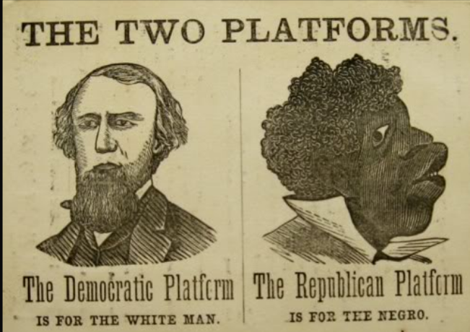
Democratic campaign poster 1876

Slide 68
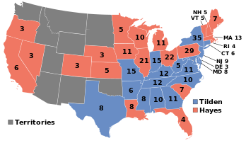
The Tied Election and the “Deal”
Widespread fraud, intimidation
And lynchings Across South to supress Black and Radical Republican vote
Democrats “win” 51% vote,
Republicans 49% Votes for Florida,
S Carolina & Louisiana
rejected by Republican Congress
Riots & killings. Grant sends army to
Restore order….Congress to decide
Election….rumours of war
Deal made…..Democrats concede
Fraudulent vote & Republicans “win”
…in exchange Reconstruction abandoned
And army leaves
Disputed elections

Slide 69
The new South 1877-1900

Slide 70
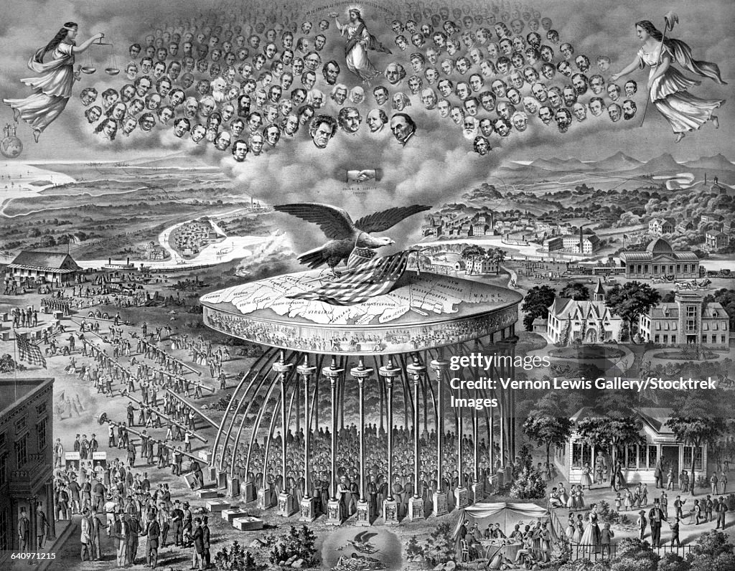
The accepted view….1880’s, nation relieved and reunited

Slide 71
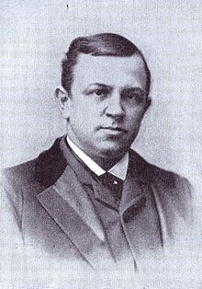
Henry Grady (1850-1889): “New South” advocate
Father confederate officer Killed at Petersburg. Educated
as Southern Gentleman, classical Tradition…studied law, interest
in languages and history. Career in journalism, editor Atlanta
Journal …voice of “New South”
Wants New South to be as North…diversified industries,
“Standing in the presence of this multitude, sobered with the
responsibility of the message I deliver to the young men of the
South, I declare that the truth above all others to be worn unsullied
and sacred in your hearts, to be surrendered to no force, sold for no
price, compromised in no necessity, but cherished and defended
as the covenant of your prosperity, and the pledge of peace to
your children, is that the white race must dominate forever in
the South, because it is the white race, and superior to that
race by which its supremacy is threatened.”
Encourages lynching newspaper headline "The Triple Trapeze:
Three Negroes Hung to a Limb of a Tree."

Slide 72
The “New South” 1877- 1900
Introduction of “Jim Crow” Laws to disenfranchise blacks
Literary tests
Grandfather clauses
Property requirements
Poll Taxes
Removal of civil liberties
Elimination of Freedman’s Bureaus
Embezzlement of pensions & Savings
Tax cuts causing closure, defunding of public schools, libraries
Enforced segregation: Black “middle class” removed from view
Radicals appeal to Supreme Court: Plessey vs Ferguson 1896 ….rule “Separate but Equal” means State “Jim Crow” laws compliant with 14th & 15th Amendment

Slide 73
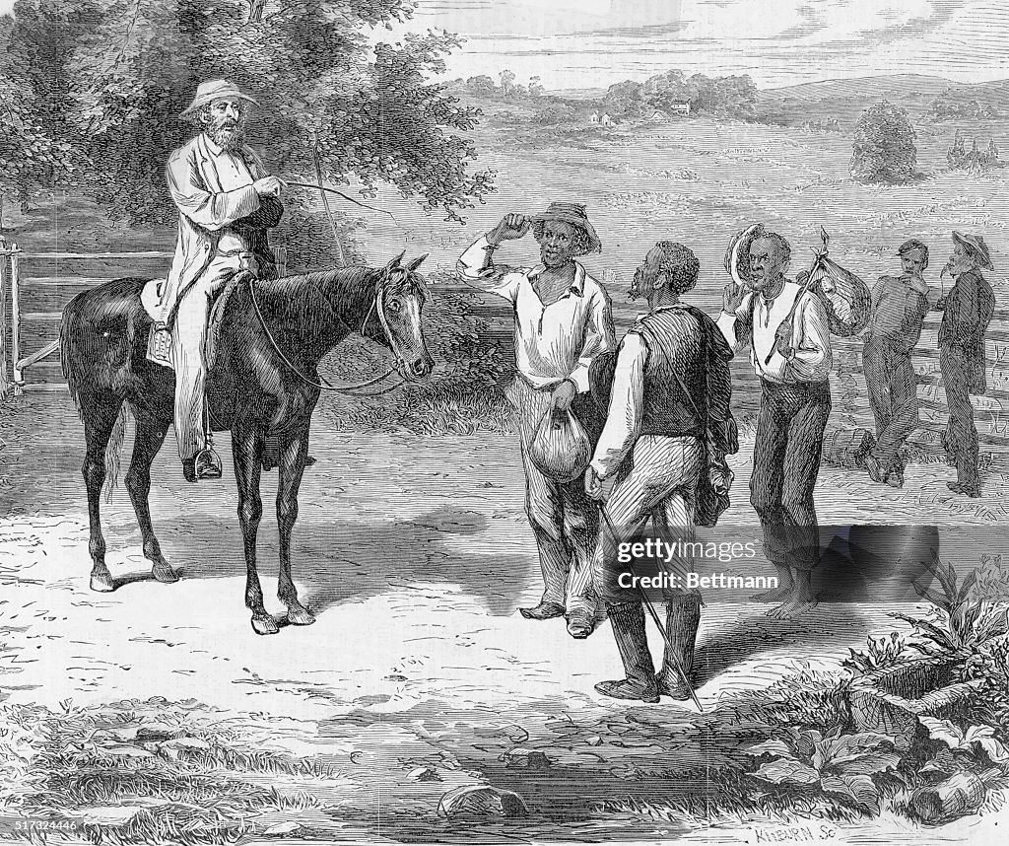
Reality: North abandons black voters ….and “old South” restored

Slide 74
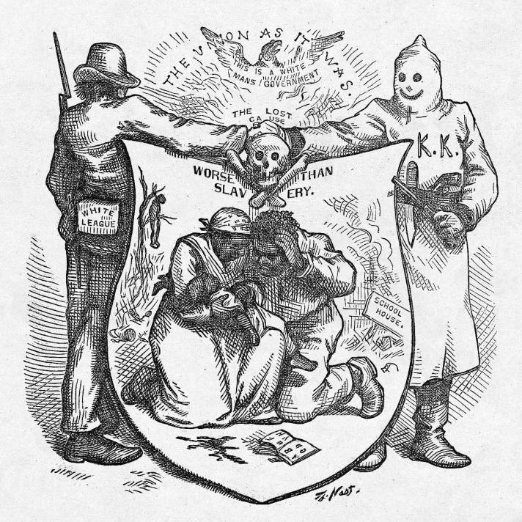
The “Lost Cause” restored
Rallying cry of the New
South”
Restored by White League & KKK (returns
In 1910…)
Zero black Congressmen
By 1890…disappear from
State Legislatures
Defines South till
1960’s

Slide 75
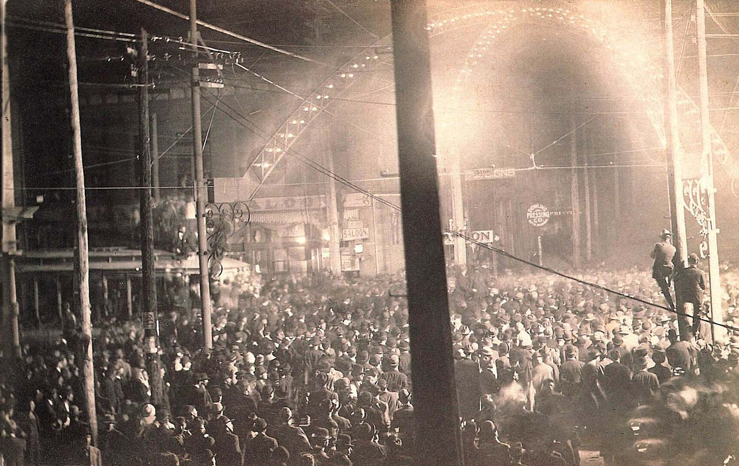
Public lynching 1909 :public acts of terror, family attend events, postcards, covered by newspapers
Many types
Individuals
And groups
Mostly males
Public occasions
often “mock trials”
Emphasis humiliation
Press often present
No limit to violence
…burning
…torture
…shootings
...hanging

Slide 76
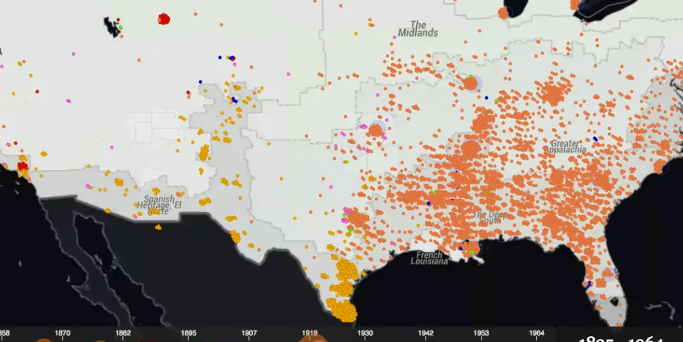
Documented lynching's 1865-1950

Slide 77
Documented Lynchings by year
New South?
“Whites”: ‘carpetbaggers
& scallywags

Slide 78
Ida Wells (1862-1931)
Born into slavery, youngest
Of 8. father carpenter
Committed to education
Becomes reporter for
Black newspapers in Memphis, TN
Married, 5 children
Witnesses lynching of black
School boy. Decides to
Document murders of black
Men and women.
Newspaper burned down
Ida to NY. Writes “Southern
Horrors” supports suffragettes
Tours Britain….gives speeches
In Birmingham!

Slide 79
Ida Wells…continued
“It is with no pleasure that I have dipped my hands in the corruption here exposed ... Somebody must show that the Afro-American race is more sinned against than sinning, and it seems to have fallen upon me to do so…..Ida Wells 1892 ““
Meets Frederick Douglas
Dear Miss Wells: Thank you for your faithful paper
on the lynch abomination now
generally practiced against coloured
people in the South. There has been
no word equal to it in convincing power
. I have spoken, but my word is feeble
in comparison ... Brave woman! ...

Slide 80
Booker T Washington (1856-1915)
Born slave in Virginia mother raped by
White owner. Freed by union troops
Self taught “The Negro worshipped books.
We wanted books, more books. The larger
the books were the better we like[d] them.
We thought the mere possession and the
mere handling and the mere worship of books
was going, in some inexplicable way, to make
great and strong and useful men of our race
Attends black college run by Freedman’s Bureau
Works in mines to fund tuition. Appointed head
Of black technical college “Tuskegee Institute”
Befriends industrialists and politicians….abandons
Attempts at getting vote…demonstrate “thrift, intelligence
And property…founds Negro Business league, black
colleges
Encourages blacks to accept “new order". For now
….criticised In his day as “Uncle Tom”….not now

Slide 81
“New South” 1900
South does not industrialise
Cotton mills, tobacco factories, steel….not diversified (except Coca Cola)
Great majority of workforce tenant farmers, sharecroppers
Wages 40% that of North
Politically marginalised
No Southerner in White House till 1912 (9/13 before war)
“Solid South” …one party culture…100% Democrat till 1960’s
Blacks 40% -60% Southern state with zero political representation post 1880
Population flat vs 50% increase in North and West
Black Schools, institutes continue
Remains two crop economy dependent on cotton price while North and West boom
Low education levels, poor roads, high levels of violence, disease, underdevelopment

Slide 82
The New South vs North Income levels 1890

Slide 83
New South = Old South….without the charm Time to move West where absolutely everything will change….Talk 20

